Slide 1

PROGRAMMING FUNDAMENTALS JAVA SUDOKU
java

Slide 2
PROGRAMMING FUNDAMENTALS JAVA SUDOKU
CAUTION!
The game is played
by professional gamers.
Do not try this at
home, school or anywhere…!!!
java

Slide 3


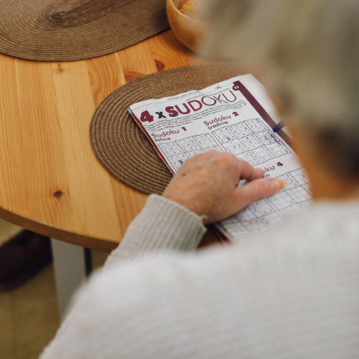
Sudoku is logic based number-placement puzzle. In classic Sudoku, The objective is to fill a 9*9 grid with digits so that each row, each column, each of the nine 3*3 subgrids that compose the grid contain all the digits from 1 to 9. The puzzle setter provides a partially completed grid, which for a well posed puzzle has a single solution
INTRODUCTION

Slide 4
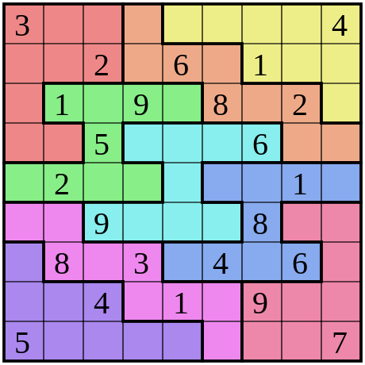
OVERVIEW
The code that we are gonna discuss implements a simple text-based Sudoku game that allows the player to fill in numbers and check the solution. The game uses recursive backtracking to solve the Sudoku puzzle. The user can input "solve" to see the solution or "quit" to end the game. For filling in numbers, the user needs to provide the row, column, and number they want to fill, separated by spaces. The game also performs input validation to ensure that the user's moves are legal.

Slide 5

display(int[][] board): This method takes a 2D array board representing the Sudoku grid and displays it in the console. It formats the output to show the 9x9 grid with horizontal and vertical dividers to represent the individual blocks.
method1(int[][] board, int row, int col, int num): This method checks if it's safe to place the given num at the specified (row, col) position on the Sudoku board. It checks for conflicts in the row, column, and the 3x3 sub-grid that contains the given cell.
sudokusols(int[][] board): This is a recursive backtracking method that attempts to solve the Sudoku puzzle using a depth-first search approach. It fills empty cells with numbers and checks for valid solutions. If it finds a valid solution, it returns true; otherwise, it backtracks and tries a different number.
METHODS:

Slide 6

2D Array: The Sudoku board is represented as a 2D array of integers int[][] board, where each cell holds a number from 0 to 9. A value of 0 indicates an empty cell.
Loops: The program uses nested loops to iterate over the Sudoku grid, rows, columns, and 3x3 sub-grids to perform various operations, such as displaying the board, checking for safe placement, and solving the puzzle.
Recursion: The sudokusols method uses recursion to explore possible combinations of numbers for empty cells until a valid solution is found or deemed impossible.
Input handling: The program takes user input using Scanner, allowing the user to enter row, column, and number to fill in a cell, check the solution, or quit the game.
ELEMENTS:

Slide 7
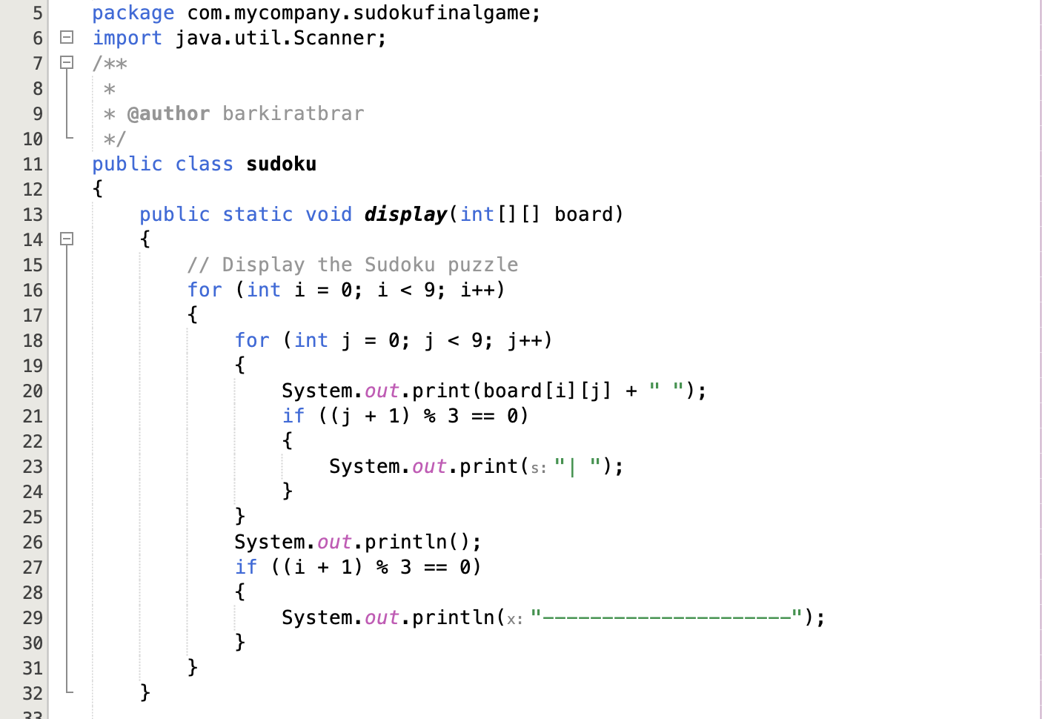



This line declares a class named sudoku.
This method, named display, takes a 2D array board as input and is responsible for displaying the Sudoku puzzle on the console.
This nested loop iterates through each cell in the 9x9 board array.

Slide 8

This line prints the value of the current cell in the board array, followed by a space.
If the current column index j is a multiple of 3, it prints a vertical bar (|) to separate the groups of three columns.

Slide 9
After completing a row, this line moves to the next line to start displaying the next row.
If the current row index i is a multiple of 3, it prints a horizontal line (---------------------) to separate the groups of three rows.

Slide 10
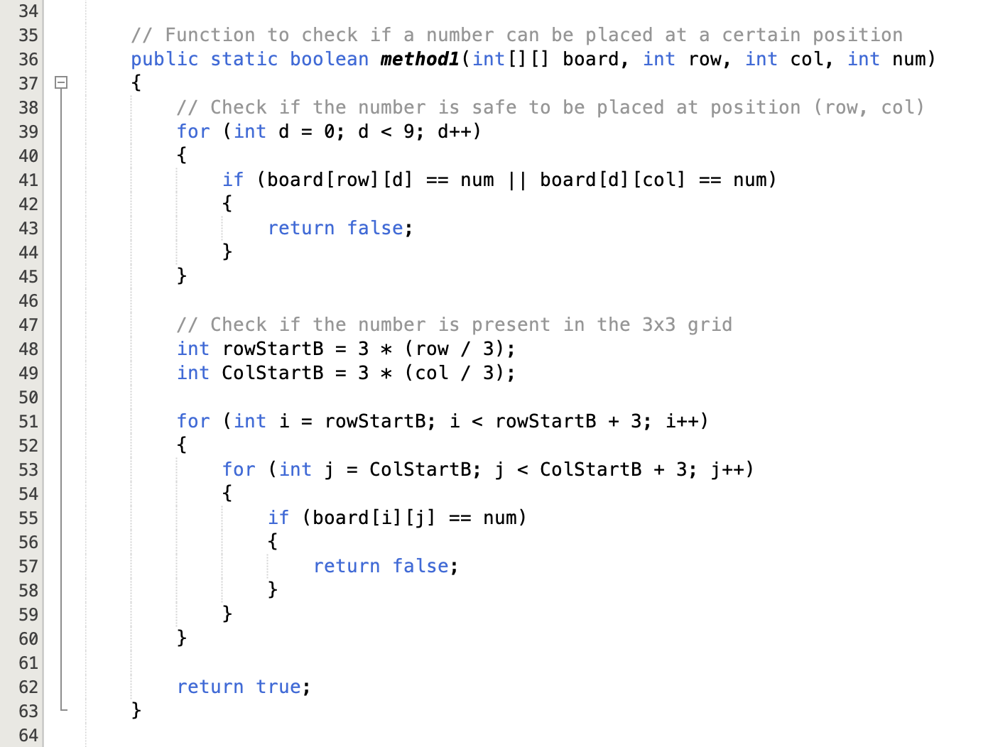


This method, named method1, checks if it's safe to place the number num at the specified row and column in the board.
This loop checks if the number num is already present in the same row or column. If it is, the method returns false, indicating that placing the number is not safe.

Slide 11
These lines calculate the starting row and column indices of the 3x3 box that contains the current cell.
These nested loops iterate through the cells within the 3x3 box.

Slide 12
These lines check if the number num is already present in the 3x3 box. If it is, the method returns false.
If the number can be safely placed, the method returns true.

Slide 13
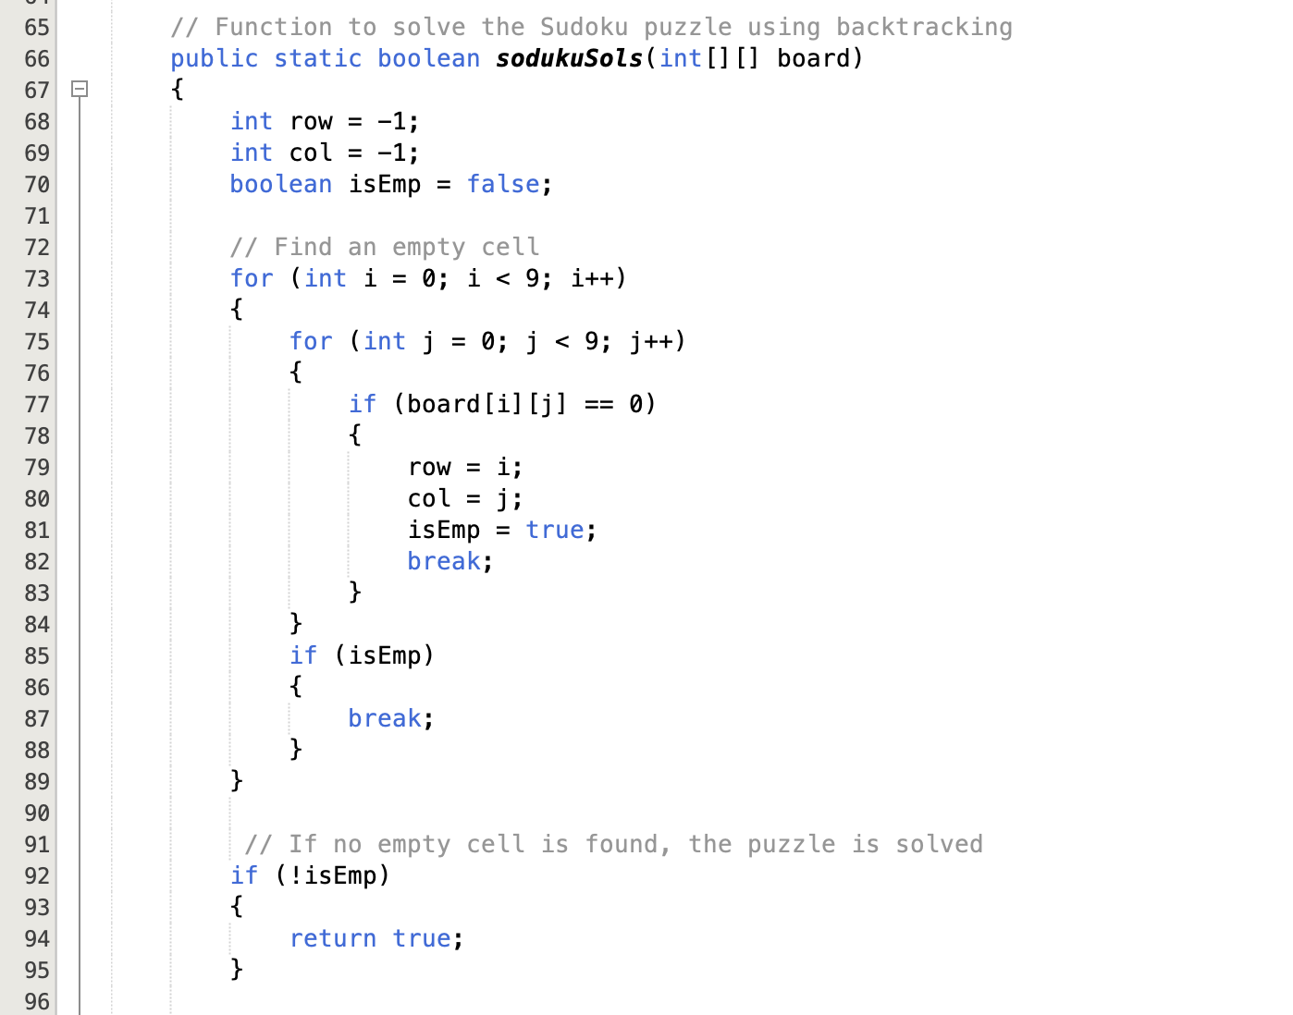

This method, named sodukuSols, attempts to solve the Sudoku puzzle using a recursive approach. It takes the board as input and returns true if a solution is found, and otherwise false.

Slide 14


These nested loops iterate through each cell in the board.
These variables are used to track the empty cell's row and column indices, and whether an empty cell is found.
These lines search for an empty cell (with a value of 0) in the board. If found, it stores the row and column indices and sets isEmp to true.

Slide 15
If no empty cells are left, the method returns true, indicating that the puzzle is solved.

Slide 16
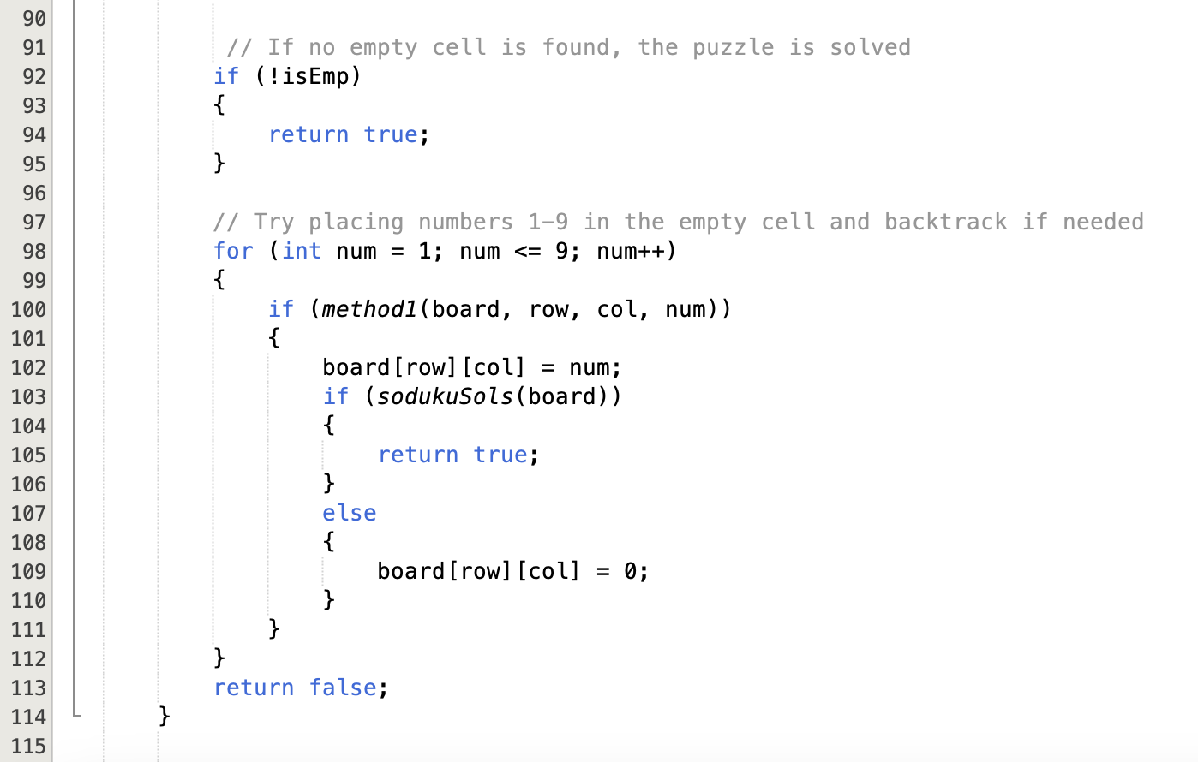

This loop iterates through numbers 1 to 9 and tries placing each number at the empty cell (row, col). It uses the method1 to check if the placement is valid. If valid, it places the number and recursively calls sodukuSols to attempt to solve the rest of the puzzle. If a solution is found, it returns true. If not, it backtracks by setting the cell back to 0 and continues trying the next number.
If no valid number can be placed, the method returns false.

Slide 17
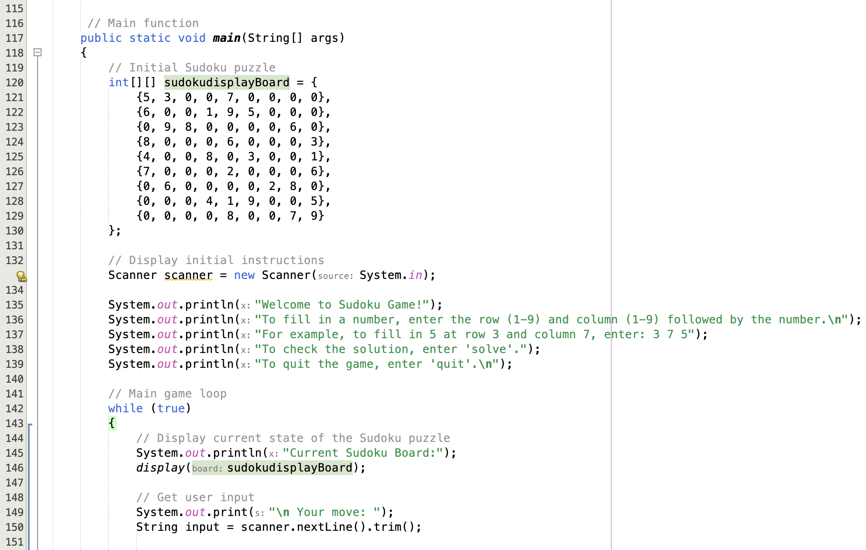
This marks the beginning of the main method, the entry point of the program.
This is the initial Sudoku puzzle board.
This creates a Scanner object to read user input from the console.
This starts an infinite loop for the game interaction.

Slide 18
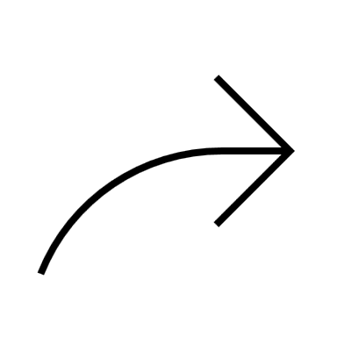
These lines display the current state of the Sudoku board.
This line prompts the user to make a move and reads their input.

Slide 19
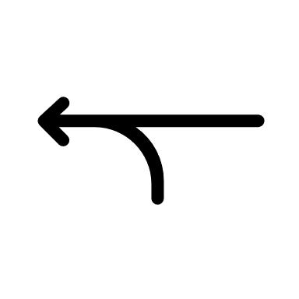
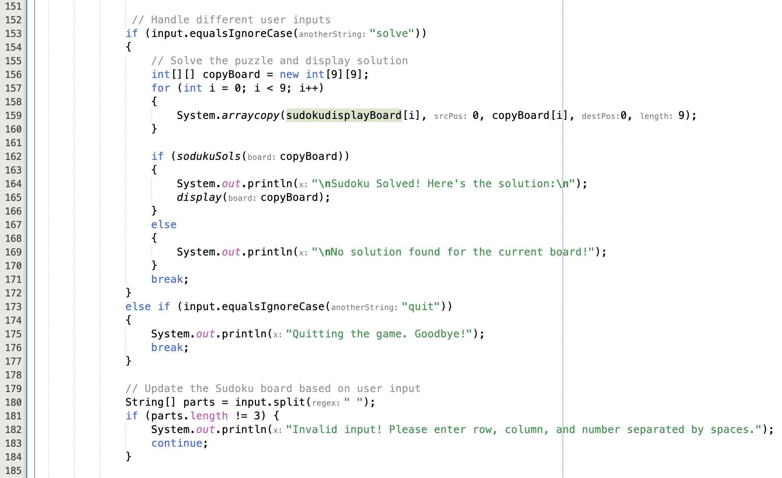
These lines handle the cases where the user wants to either solve the puzzle or quit the game.
These lines split the user input into three parts: row, column, and number. If the input doesn't have exactly three parts, it displays an error message and continues to the next iteration of the loop.

Slide 20
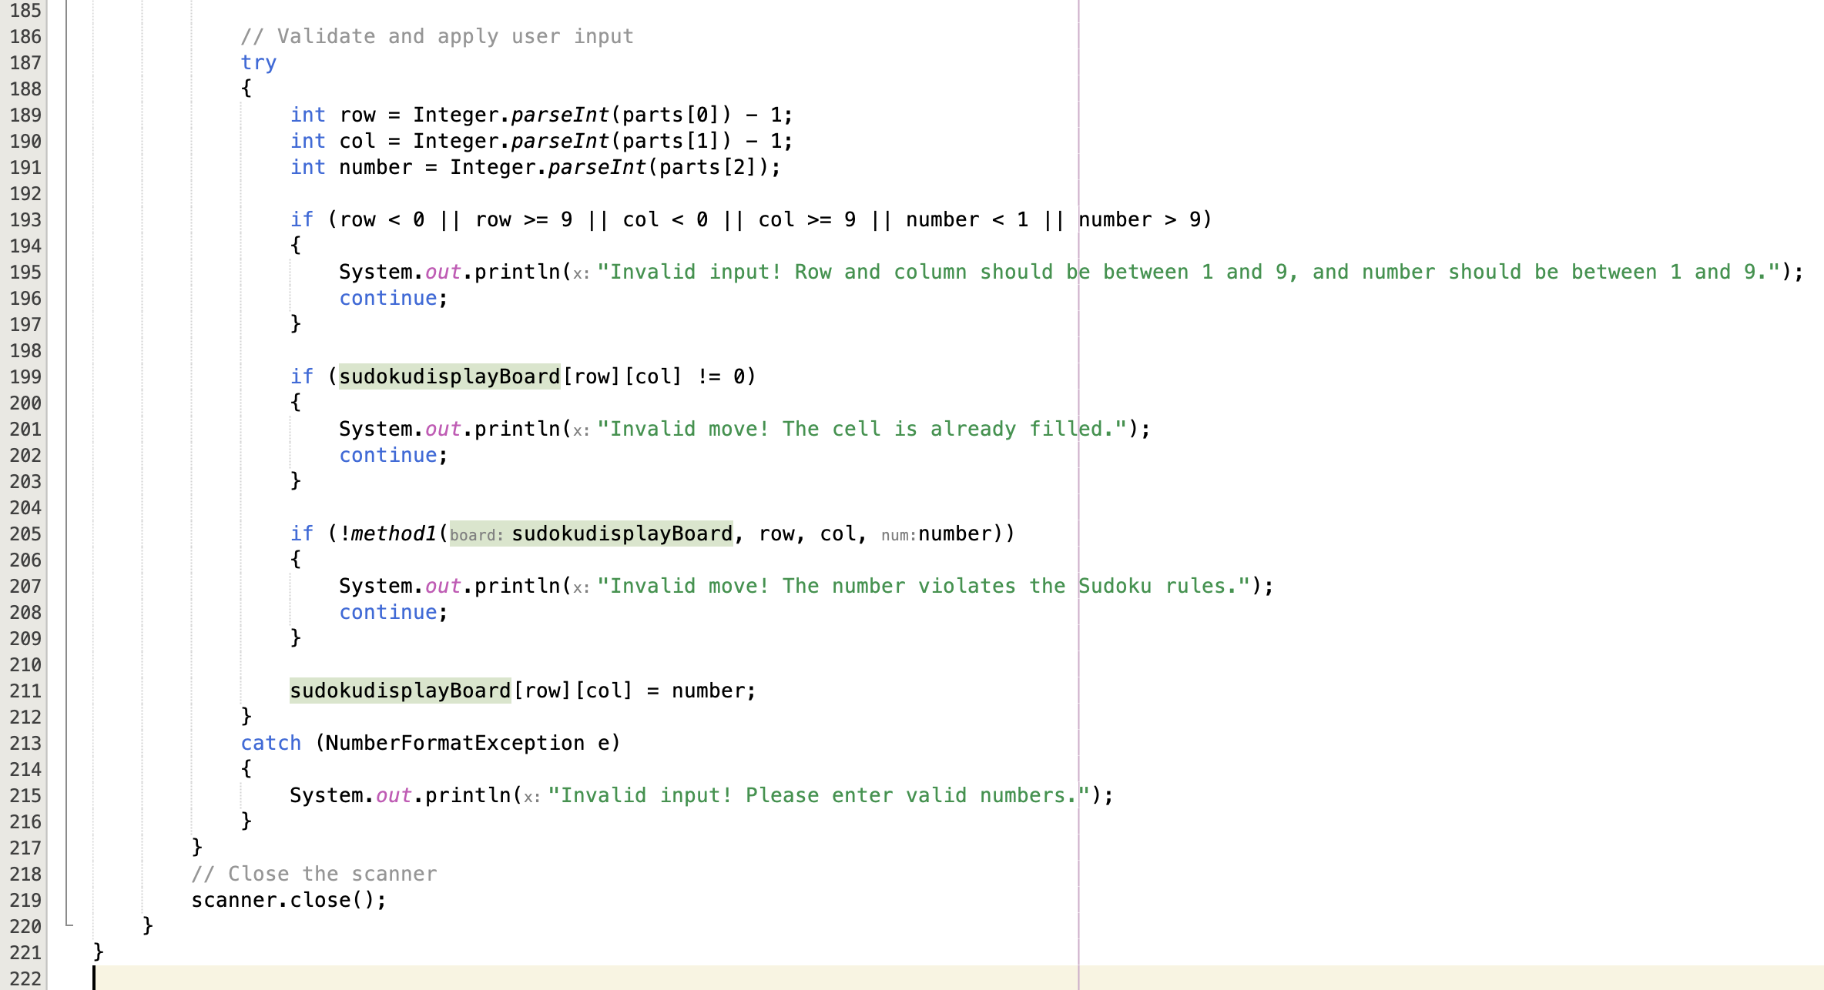
These lines parse the row, column, and number from the input parts.
These lines check if the parsed values are within the valid range.
These lines check if the cell is already filled. If it is, the user's move is invalid.
These lines check if placing the number in the cell violates any Sudoku rules.

Slide 21

These lines update the sudokudisplayBoard with the user's valid move. If there's an exception while parsing the numbers, it catches the exception and displays an error message.
This closes the Scanner and marks the end of the main method and the program.

Slide 22

Thank You!!!
Presented to: Meharban Siddique
Presented By:
Mohmed Sameer Yunus Patel

